Slide 1
Lec - 4

Slide 2

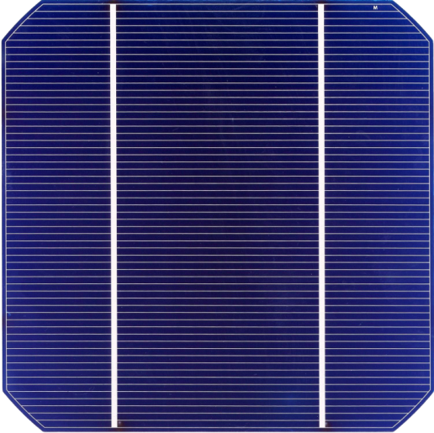
PRODUCTION OF ELECTRICITY FROM
SOLAR ENERGY
To obtain electricity from the solar energy, there are two methods
SOLAR CELL
SOLAR THERMAL
POWER PLANT
LIGHT
ELECTRICITY

Slide 3
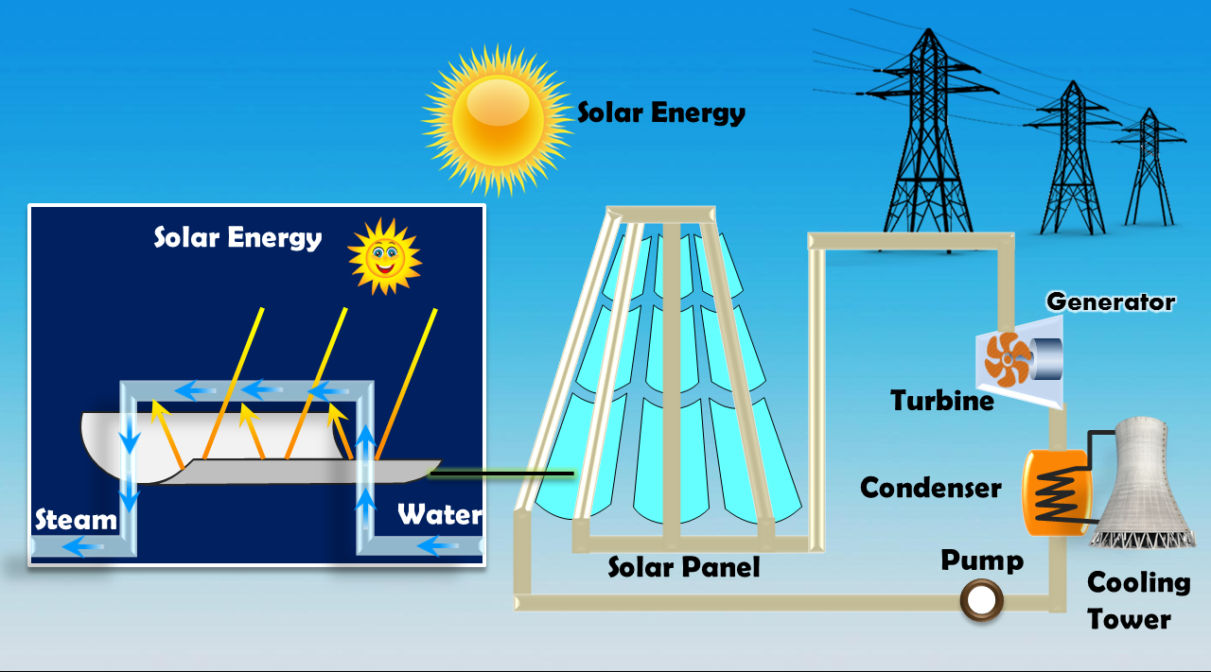
PRODUCTION OF ELECTRICITY FROM
SOLAR ENERGY
To obtain electricity from the solar energy, there are two methods
MECHANICAL
ENERGY
SOLAR HEAT
STEAM
ELECTRICITY
SOLAR THERMAL
POWER PLANT

Slide 4
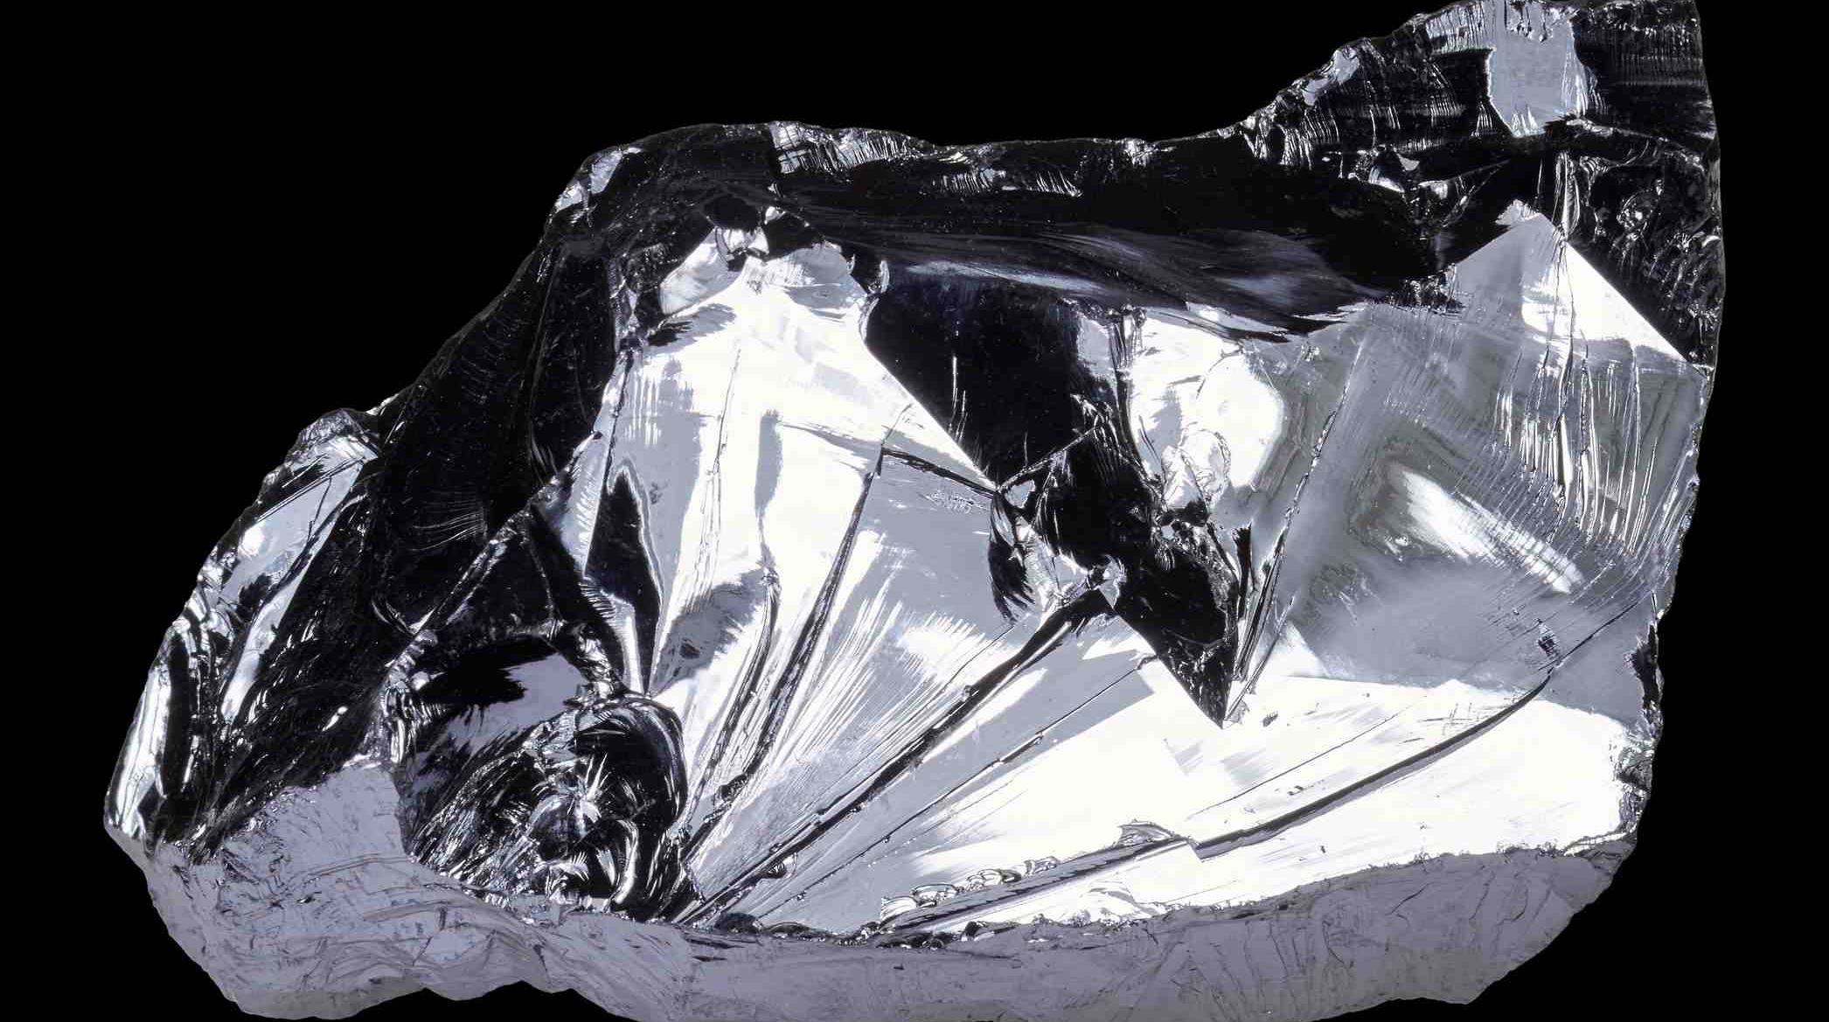
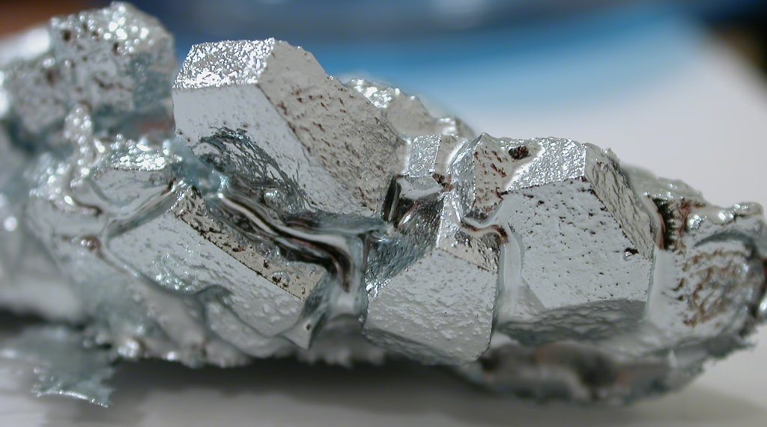
PRODUCTION OF ELECTRICITY FROM
SOLAR ENERGY
GALLIUM
SILICON
The solar cells are usually made from semiconductors like silicon and gallium.

Slide 5

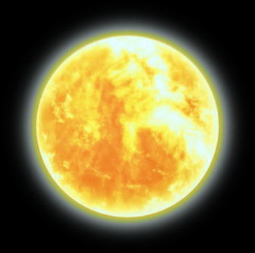


Due to potential difference, a current flows in the circuit connected between the opposite faces of the semiconductor.
+
–

Slide 6
PRODUCTION OF ELECTRICITY FROM
SOLAR ENERGY
SOLAR CELL
VOLTAGE
0.5 volt – 1.0 volt
POWER
0.7 watt

Slide 7
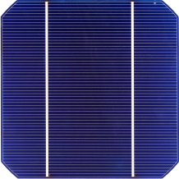
PRODUCTION OF ELECTRICITY FROM
SOLAR ENERGY
LOW EFFICIENCY
PRODUCE SUFFICIENT ELECTRICITY

Slide 8
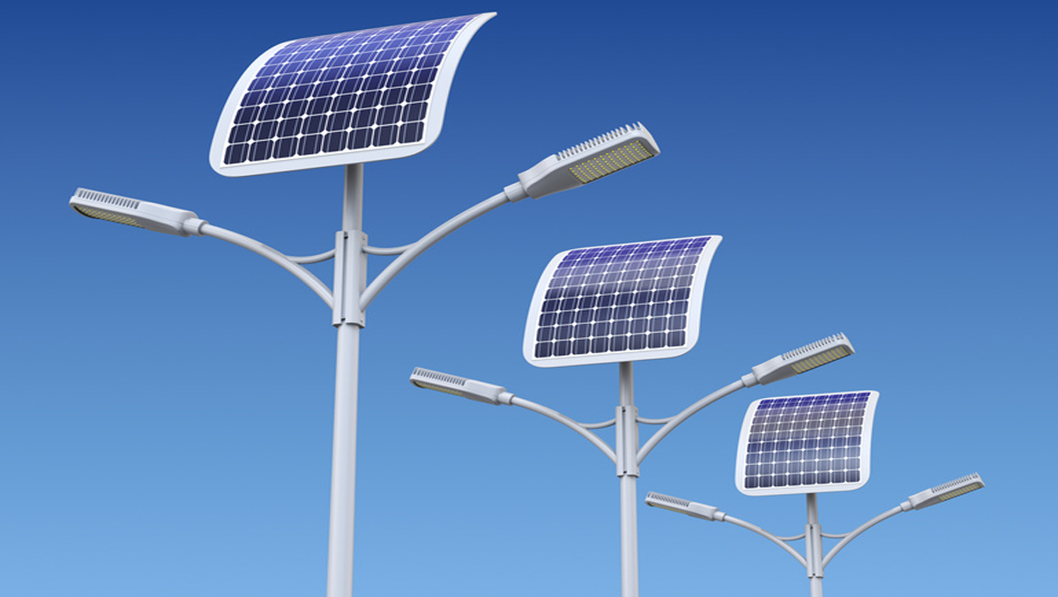


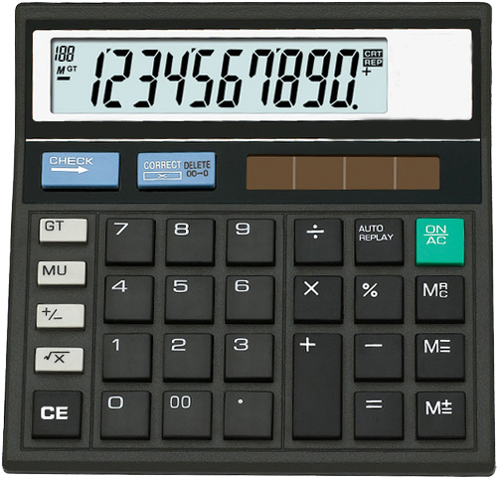
STREET
LIGHTS
PRODUCTION OF ELECTRICITY FROM
SOLAR ENERGY
ARTIFICIAL
SATELLITE
CALCULATOR
USES

Slide 9

ADVANTAGES OF USING
SOLAR PANELS
They do not require any maintenance.
They last over a long period of time.
Their running cost is almost zero.
They are most suitable for the remote, inaccessible, and isolated places where electric power lines cannot be laid.
DISADVANTAGES OF USING
SOLAR PANELS
The initial cost of a solar panel is sufficiently high.
The efficiency of conversion of solar energy to electricity is low.

Slide 10
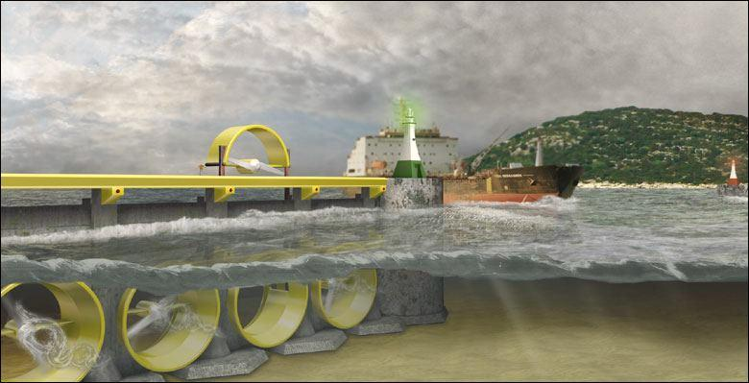
TIDAL
POWER PLANT

Slide 11






TIDE :
Rise & fall in sea- level due to the gravitational force between Earth, Moon and Sun.
HIGH TIDE
LOW TIDE
Generator
Dam
Generator
Dam
Sea
Sea
Reservoir
Reservoir
Limitations of Tidal Energy :
POTENTIAL ENERGY
KINETIC / MECHANICAL ENERGY
ELECTRICITY
1) Rise and fall of water is insufficient to generate electricity on large scale.
2) The locations where such dams can be built are limited .

Slide 12

OCEAN AS
SOURCE OF ENERGY
WATER IN OCEANS POSSESSES ENERGY IN TWO FORMS
OCEAN THERMAL
ENERGY
OCEANIC WAVES ENERGY

Slide 13


OCEAN THERMAL
ENERGY
The warm surface water is used to boil a volatile liquid like ammonia. The vapours a ammonia is used to run the turbine of generator.
Water at the surface of an ocean gets heated by absorbing the heat of sun
HEAT
Hot water – Cold water > = 20°C
2 km
Water at its deeper levels
remains cold.
COLD

Slide 14
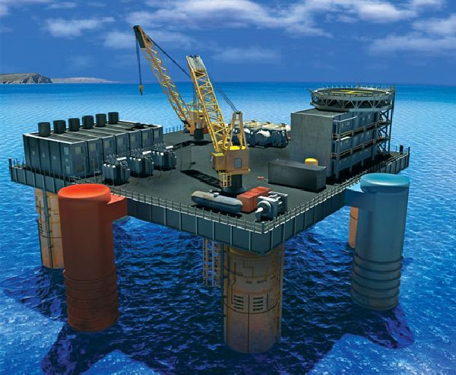
Ocean thermal energy is harnessed for producing electricity by a device called ocean thermal energy conversion power plant (OCTEC power plant).

Slide 15
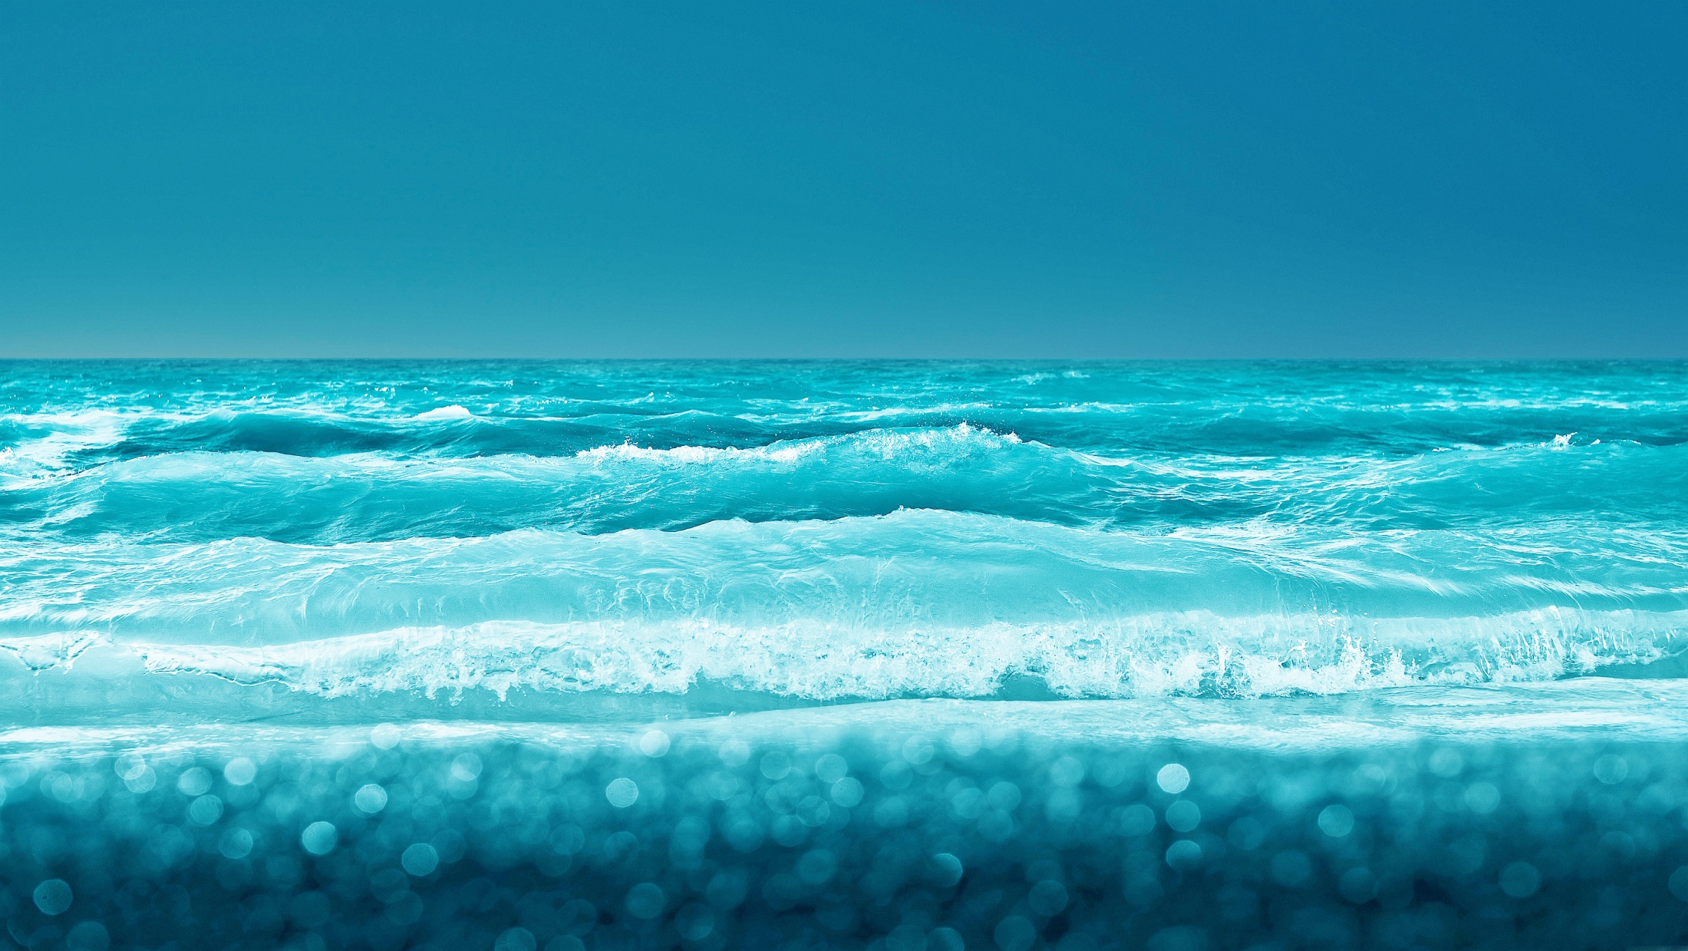
OCEANIC WAVES ENERGY
Waves move at high speed on its surface are called as OCEANIC WAVES
HIGH KINETIC
ENERGY

Slide 16
Thank You

